Slide 1
StructureMapping Your Way to Better Software
Matt Honeycutt
@matthoneycutt
http://trycatchfail.com

Slide 2
The Plan
Better software?
StructureMap Basics
Advanced Recipes
StructureMap in Action

Slide 3
SOLID Principles
Single Responsibility
Open-Closed
Liskov Substitution
Interface Segregation
Dependency Inversion

Slide 4
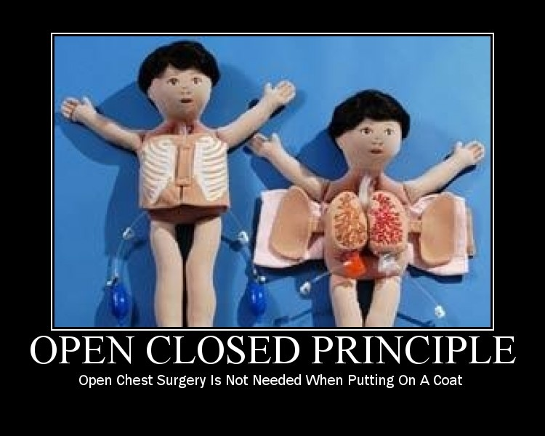
SOLID
Notes:
* To code!

Slide 5
Why Use StructureMap?
Design
One of the fastest IoC containers
Fully-loaded
Easy to learn Domain Specific Language
Achieve loose coupling
Extensibility everywhere
Improve testability
SOLID!
Features
Mature: one of the oldest containers
Notes:
* Code

Slide 6
Code!

Slide 7
Everyone Loves WebForms!

Slide 8
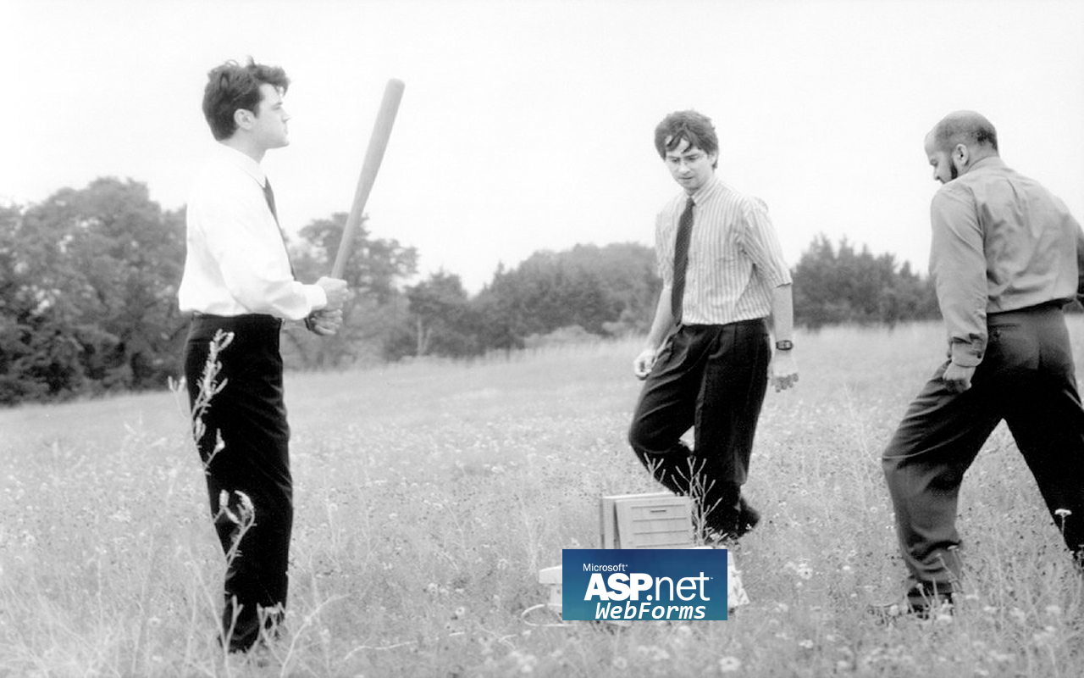

Slide 9
Service Locator
Design pattern which encapsulates the processes involved in obtaining a service.
Requester Asks the locator for a particular service.
Service Locator Based on configuration, builds up and returns the requested service.
Notes:
* Back to code!

Slide 10
Model-View-Presenter
MVP is a user interface design pattern engineered to improve the separation of concerns within an application’s presentation layer.
Model Object that defines the data to be displayed.
View Interface that displays the data.
Presenter Acts upon the model, tells the view what to do.
Notes:
Back to code!

Slide 11
ASP.NET MVC DependencyResolver
http://mysite/Home/Index
Hey, give me the HomeController!
ASP.NET MVC Pipeline
DependencyResolver
Here ya go!
Activator.CreateInstance(
typeof(HomeController));

Slide 12
ASP.NET MVC DependencyResolver
Hey, give me the HomeController!
ASP.NET MVC Pipeline
SmDependencyResolver
Here ya go!
Container.GetInstance(
typeof(HomeController));

Slide 13
Decorator Pattern
Design pattern that allows behavior to be added to an object at runtime.
Decorated Type Base type that implements in the interface.
Decorator Wraps an instance of the service interface to add new behavior.
Service Interface Defines the public contract for the type being extended.

Slide 14
Decorator Pattern
SomeOtherDecorator : IProductRepository
ProductLoggingDecorator : IProductRepository
InMemoryProductRepository : IProductRepository

Slide 15
Think compositionally! “Favor composition over inheritance!”

Slide 16
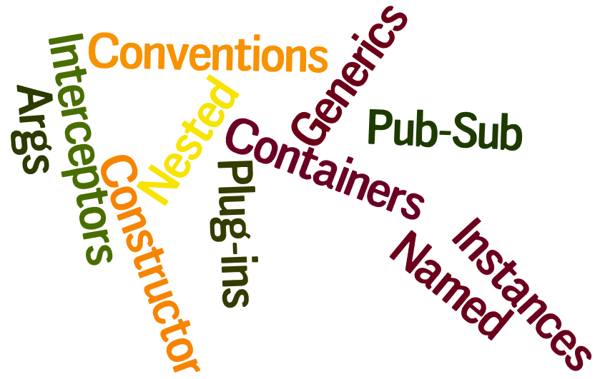
We’ve only just begun!

Slide 17
To Recap
IoC rocks. Use it. Embrace it!
There’s a learning curve… but it’s worth it!
Makes it easier to create SOLID code.
Do it all with StructureMap!

Slide 18
Want to know more?
http://trycatchFAIL.com Blog, Videos, and More!
@matthoneycutt
I might say something interesting some day…

